Slide 1
Requirements
DNS
Email server
Message Parser
Network
IR transmitter
Z-Wave
ZigBee
Integration
Technologies
X-10
Insteon
Arduino
Raspberry Pi

Slide 2
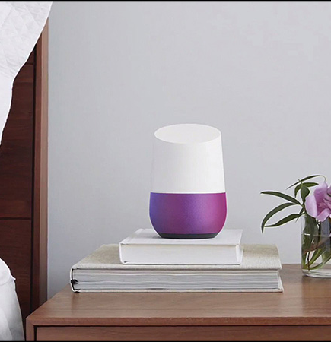
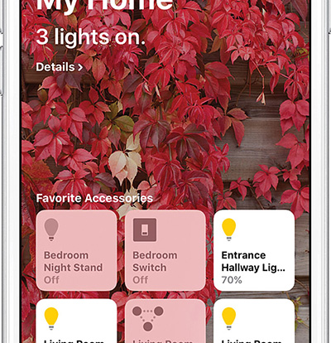

Smart home controllers

